Slide 1
Service Shop Analytics

Slide 2
Recipe Card
Recipe Cart Details
Segmentation
Customer Segmentation
Parts Segmentation
Recency , Frequency & Monetary [RFM]
Propensity to Buy Model

Slide 3
Recipe Card
Ingredients / Actions | Model Consideration
Total IB (Install Base) | Yes
Modalities | Yes
Contract Status (Yes/No/Parts Pool) - IW/IC/IBOW/HBS | Yes
System (Equipment) 1. Types (PSI/PSN) - Names / IDs 2. # of MultiVendor Systems vs # of GE Systems 3. Age of the systems | Yes
# of Total and Unique Systems | Yes
Order Patterns / Order History* | Yes
Order Frequency | Yes
Common Part Orders | WIP
Discount % / Entitlements / Agreements /Discount Sensitivity | WIP
Shopping Behavior / Patterns - Online vs Offline vs. FE Parent Location vs Children | WIP
List of Parts associated with the systems | Yes
Customer Segmentation (Large In-House Concierge) | WIP
Part Share (need common measure) -% of total -% of opportunity (Parts Only) | WIP
Mean Time of Part Failure (MTBF) Do they request repair through the web site? | WIP

Slide 4



Customer Profiling
Occasional Customers
Frequent Customers
Potential Customers
No. of unique Customers
9050(75%)
No. of unique Customers
38(2%)
No. of unique Customers
2774(23%)
Frequency:
Average frequency for customers is 1 time per annum
Amount:
64% of the customers have generated revenue per transaction of upto $1,500
Discount Received:
66% of the customers get No discount
Quantity Per Transaction:
On an Average,80% have purchsed less than 1 Quantity per transaction
Frequency:
Average frequency for customers is 170 times per annum
Amount:
53% of the have generated revenue per transaction of more than $3,000
Discount Received:
29% of the customers upto 20% Discount.
Quantity Per Transaction:
On an Average,86% have purchsed more than 1 Quantity per transaction
Frequency:
Average frequency for customers is 5 times per annum
Amount:
25% have generated revenue per transaction between $1500 - $3000
Discount Received:
93% of the customers get more than 20% discount
Quantity Per Transaction:
On an Average,69% have purchsed less than 1 Quantity per transaction

Slide 5
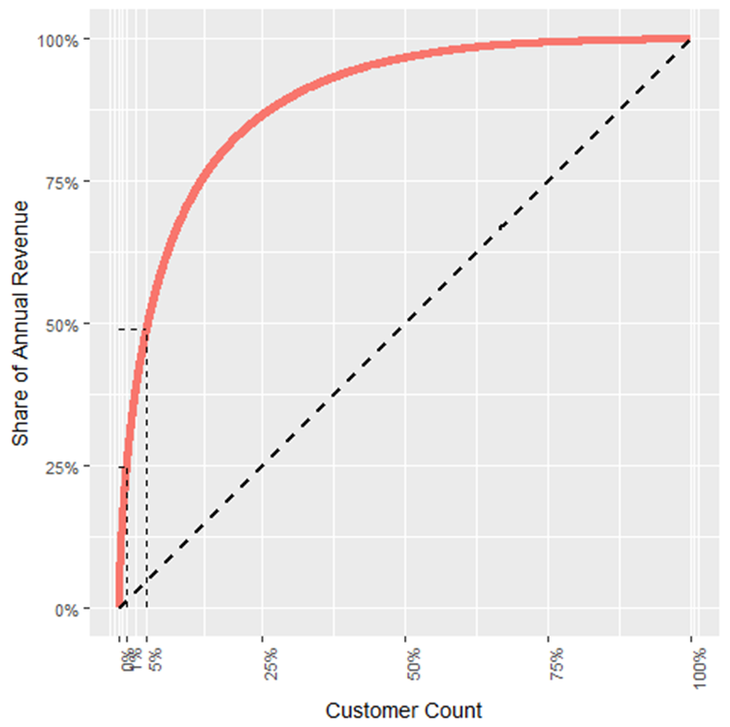
Profile -1 | Potential Customers
Top Revenue Generating Customers
No. of Master Customer | 84
No. of Customers | 132
Total Revenue (MM$) | 9.06
Avg Discount % | ~2%
Avg Margin% | ~86%
Average Annual Frequency | 15
76% of customers contribute to
30% of revenue
Bill to Accounts | Revenue per annum | % of Cluster Revenue
UMASS MEMORIAL MEDICAL CENTER | $136,902 | ~1%
DOCTORS MEDICAL CENTER OF MODESTO INC | $127,724 | ~1%
MOUNT AUBURN HOSPITAL | $95,338 | ~1%
SISTERS OF CHARITY OF LEAVENWORTH HEALTH SYSTEM INC | $91,937 | ~1%
ASANTE HEALTH SYSTEMS | $88,120 | ~1%
Zone | # of Customers | % of Customers | Total Revenue (MM$) | % Revenue
Central | 1750 | 20% | 21.7 | 21%
North Central | 729 | 8% | 6.8 | 6%
North East | 801 | 8% | 6.4 | 6%
South Central | 442 | 4% | 6.6 | 6%
South East | 817 | 9% | 6 | 5%
East | 2013 | 22% | 26 | 25%
West | 963 | 10% | 12.6 | 12%
Top 5 customers generate 5% (1 MM$) of annual revenue
Top 1% (90) customers generate 25% (5 MM$) of annual revenue
Top 5% (450) customers generate 50% (10 MM$) of annual revenue
22% customers are from East Zone with
highest revenue contribution per annum (25%)

Slide 6
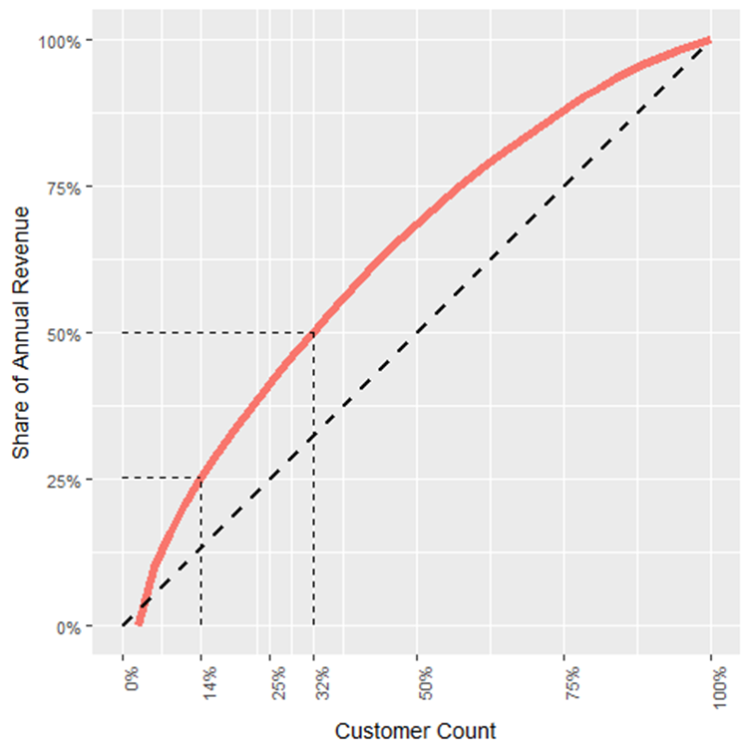
Profile -2 |Frequent Customers
No. of Master Customer | 24
No. of Customers | 83
Total Revenue (MM$) | 11.09
Avg Discount % | ~26%
Avg Margin% | ~73%
Average Annual Frequency | 62
Top Revenue Generating Customers
22% of customers conritbute to
36% of revenue
Bill to Accounts | Revenue per annum | % of Cluster Revenue
CATHOLIC HEALTH INITIATIVES IN | $1,818,098 | 9%
UPMC HEALTH SYSTEM | $1,108,343 | 6%
NOVANT HEALTH INC | $901,296 | 4%
VA CHIEF FISCAL DIVISION 901A | $868,083 | 4%
MERCY HEALTH | $744,728 | 4%
Zone | # of Customers | % of Customers | Total Revenue (MM$) | % Revenue
Central | 11 | 30% | 28 | 31%
East | 11 | 30% | 33 | 36%
North Central | 1 | 3% | 1.5 | 2%
North East | 2 | 5.5% | 5.3 | 6%
South Central | 1 | 2.8% | 3.4 | 4%
South East | 1 | 2.8% | 2 | 2%
West | 6 | 16% | 11 | 12%
WE | 3 | 9% | 6 | 6%
Top 5 customers generate 27% (4.6 MM$) of annual revenue
Top 14% (6) customers generate 28% (4.9 MM$) of annual revenue
Top 32% (12) customers generate 50% (9.2 MM$) of annual revenue
30% customers are from Central Zone and East with Highest revenue contribution from the East Zone(36%)

Slide 7
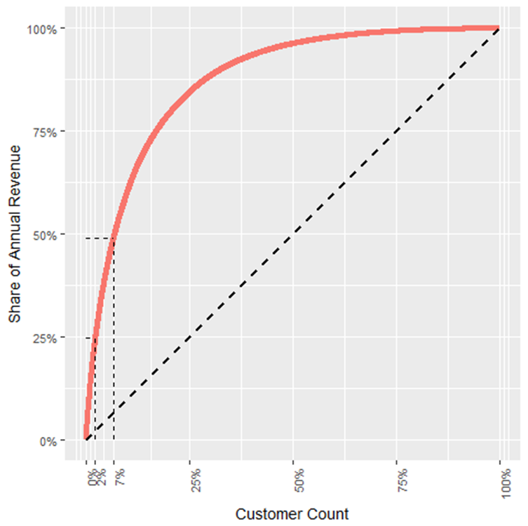
Profile -3 | Potential Customers
Top Revenue Generating Customers
No. of Master Customer | 2
No. of Customers | 138
Total Revenue (MM$) | 10.52
Avg Discount % | ~31%
Avg Margin% | ~68%
Average Annual Frequency | 770
2% of Customers contribute to
34% of Revenue
Bill to Accounts | Revenue per annum | % of Cluster Revenue
INDIANA UNIVERSITY HEALTH INC | $320,540 | ~1%
ABINGTON MEMORIAL HOSPITAL | $320,073 | ~1%
H LEE MOFFITT CANCER CENTER & RESEARCH INSTITUTE INC | $308,437 | ~1%
NORTH MISSISSIPPI MEDICAL CENTER INC | $271,974 | ~1%
ARAMARK HEALTHCARE | $262,658 | ~1%
Zone | # of Customers | % of Customers | Total Revenue (MM$) | % Revenue
Central | 566 | 20% | 63 | 27%
East | 575 | 21% | 60 | 25%
North Central | 257 | 9% | 9.4 | 4%
North East | 188 | 7% | 12 | 5%
South Central | 203 | 7% | 18 | 8%
South East | 270 | 10% | 19.5 | 8%
West | 208 | 7% | 24 | 10%
Top 5 customers generate 5% (2.4 MM$) of annual revenue
Top 2% (55) customers generate 25% (12 MM$) of annual revenue
Top 7% (194) customers generate 50% (23 MM$) of annual revenue
21% customers are from East Zone however highest revenue contribution is from the Central Zone(36%)

Slide 8
Parts Clustering
Top Demand Items
Most Profitable Items
High Discount Items
No. of unique Items
84(1%)
Total Annual Revenue
6.3 MM$ (6%)
No. of unique Items
7925(49%)
Total Annual Revenue
18.4 MM$ (17%)
No. of unique Items
7994(50%)
Total Annual Revenue
85 MM$ (78%)
List Price:
55% of these unique items has a list price less than or equal to 250$
Annual Sale Volume:
53% of these items have annual sale volume greater than 100 units
Discount Offered:
53% of these Items are being sold with 15 to 30 percent discount on the list price
Profitability:
67% (56) items have a profit earning between 50% and 75%.
List Price:
43% of these unique items have a list price between 250$ and 1000$
Annual Sale Volume:
99% of these items have annual sale volume less than or equal to 100 units
Discount Offered:
75% of these Items are being sold with less than or equal to 15 percent discount on the list price
Profitability:
55%(4352) items have a profit earning greater than 75%.
List Price:
56% of these unique items have a list price greater than 1000$
Annual Sale Volume:
99% of these items have annual sale volume less than 100 units
Discount Offered:
57% of these Items are being sold with more than 30 percent discount on the list price
Profitability:
39% of items have a profit earning less than or equal to 50%.
Data used : 2013 – till date
18% of parts sales are from North Central zone followed by Central (12%), East(11%) and South East (11%)

Slide 9

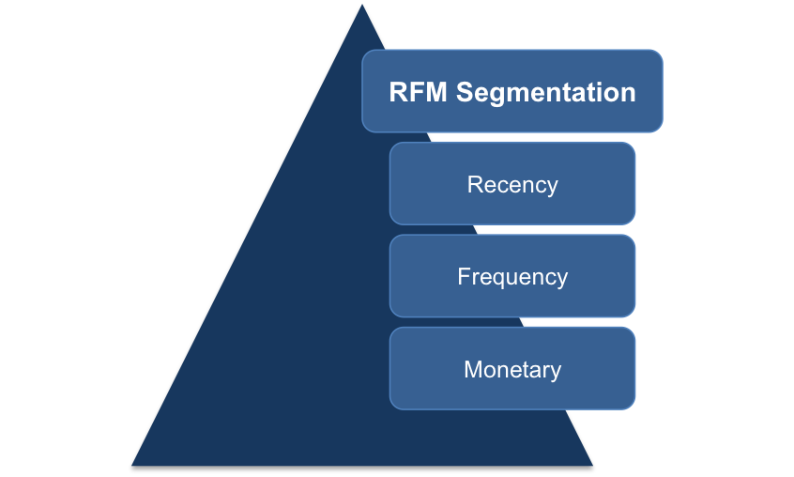


Recency, Frequency & Monetary [RFM]
Input
Customer last purchase date
Statistical Based Algorithms
Number of items bought
Recency Weight
Weighted Customer RFM score
Frequency Weight
Monetary Weight
Total amount spent by the customer
PERCENTILE SCORE

Slide 10
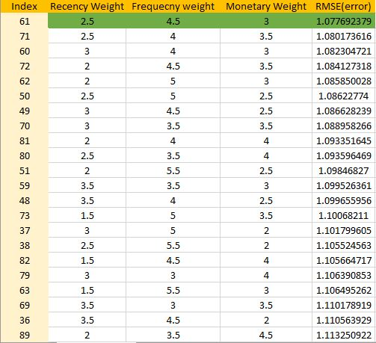
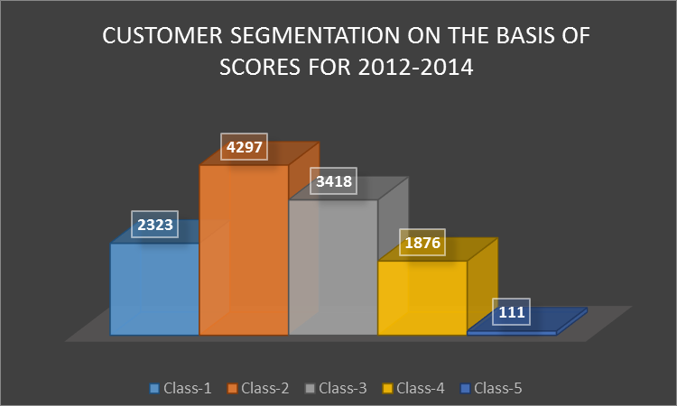
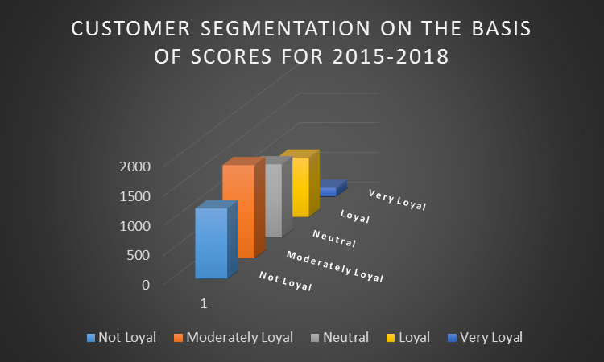

RFM Model Output
Find the best combination of weights
Data Considered:
Non-contractual Consumption (2012-2018)
Only 3 observations were available for 2012
Weights Selected with minimum error

Slide 11
Propensity Score Model
Work in progress
Product Group (Asset)
Product Type
Customer Zone
Sub Modality
Manufacturer
Age of the Asset
Customer Class
Annual Service Frequency
Annual spending on Services
No of Assets customer possess
R-Square (Feature ability to predict)
RMSE (Technique to calculate prediction error)
Actual Spending
Calculate Propensity Score and Rank
Accuracy Tests
Identify additional statistically significant
features to include into existing model
COMPARE
Train model using contractual consumption data
Predicted Consumption
Accuracy assessment and optimization of the modeling approach further
Predict consumption when asset is out of contract/warranty coverage
Customer Segment
RFM Score*
Mean Time b/w Failure of Assets
…..
Basic Model
Model Parameter Tuning
Accuracy Test
Finding Most Robust Model
Additional Features
Deployment

Slide 12


